Slide 1

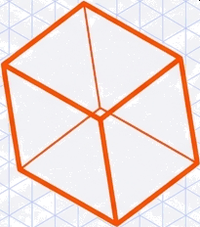

The Challenge of Perception
A physical object rarely appears ’perfectly’ to a camera lens. The real world is 3D and dynamic; the camera captures a static 2D slice. To a computer, a rotated cup is mathematically distinct from an upright cup.
Real World Object (3D)
Sensor Capture
Transformed Image (2D)
Gap: To bridge this perception gap, we use Image Transformations to mathematically
map and correct changes in rotation, translation, scale, and perspective.

Slide 2
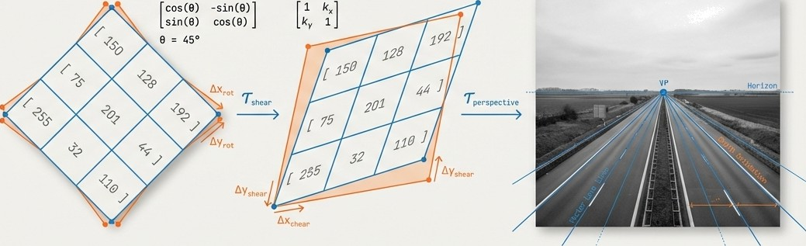
Geometric Image Transformations
From Pixels to Pefspective: A Foundational Guide for Computer Vision & Robotics.
150 | 128 | 192 | ]
[ 75 | 201 | 44 | ]
255 | 52 | 110 |  | ]

Slide 3
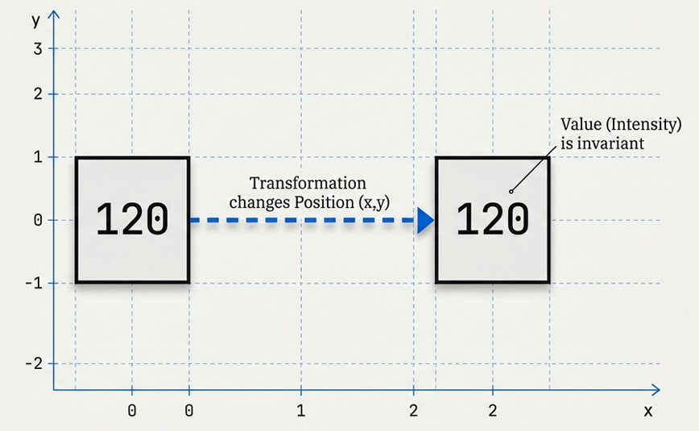
The First Truth: An Image is Just a Grid of Values
To understand transformations, we must distinguish between two properties of a pixel:
1. Position: The coordinates (K, y).
2. Value: The intensity(e.g., 120 in
grayscale) or color (RGB).
-
The Golden Rule: Geometric transformations change the Position, never the Value.

Slide 4
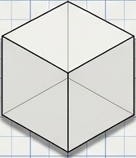
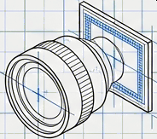
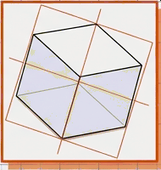
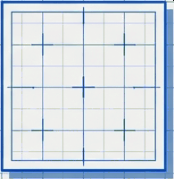
Cameras Capture a Distorted Reality
When a robot sees an object, it rarely appears ”perfect.” The object might be rotated, shifted, zoomed, or viewed from an extreme angle. To track an object or map an environment, we must mathematically relate different views to the same physical object.
Math /
Correction
Distortion
Real Obj ect (Phys1ca1 Truth)
Camera Lens/Sensor
Trans fo rmed Isa ge (Came r a 0u t put )
Co r rected Image

Slide 5

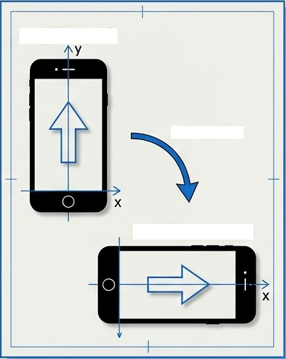
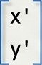
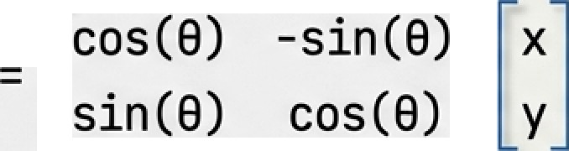
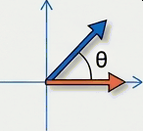

Level : Orthogonal Transformation
Rotation
Definition:
Moves pixels via
Reflection
Rotation Matrix
Step 1: Potrait
rotation or reflection (mirroring).
Rotate 90°
Constraints:
Shape, size, and
angles do NOT
change.
Distances are
preserved.
X ' = X COS(8) - y sin(8)
y' = x sin(B) + y oos(B)
Step 2: Landscape
Example: Screen rotation. The content
rotates, but the icon size is identical.

Slide 6
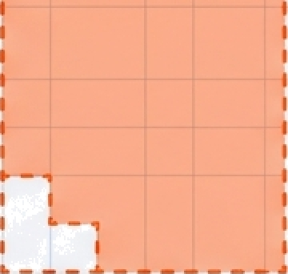
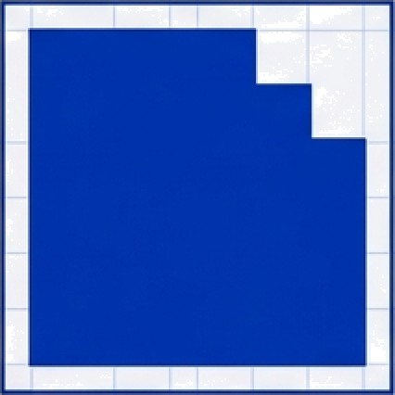
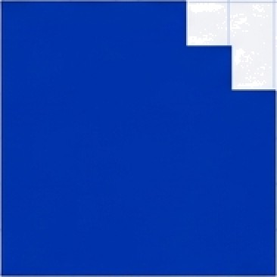

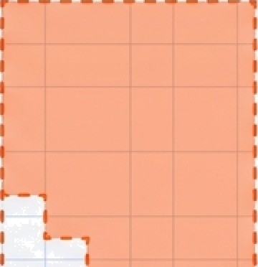

Level 1: The Rigid World (Orthogonal)
The strictest form of movement. There is no size change and no distortion. The object simply
re-orients itself or flips.
Rotation
Real World Use
Correcting smartphone screen
orientation (Portrait/Landscape).
„ :.. .

Slide 7
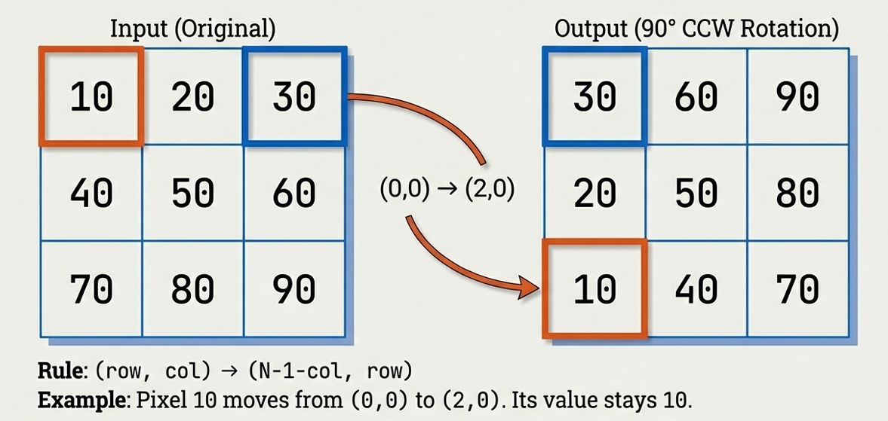
Tracing the Pixel: 9O° Rotation Logic

Slide 8

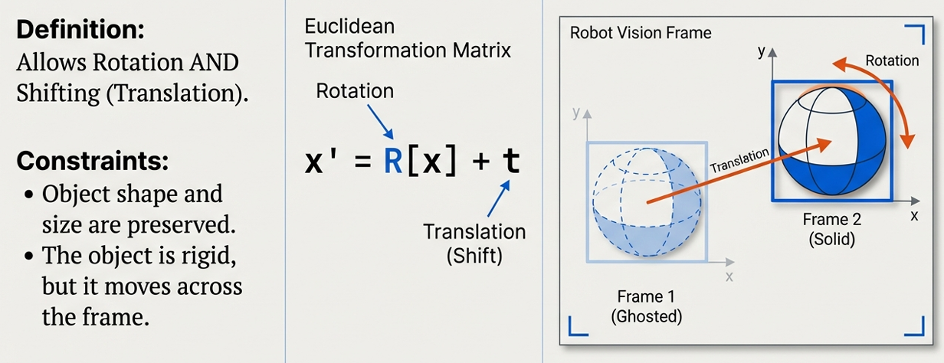

Level Euclidean Transformation
Rotation + Translation (Shift)
x' = R[x] -r I

Slide 9

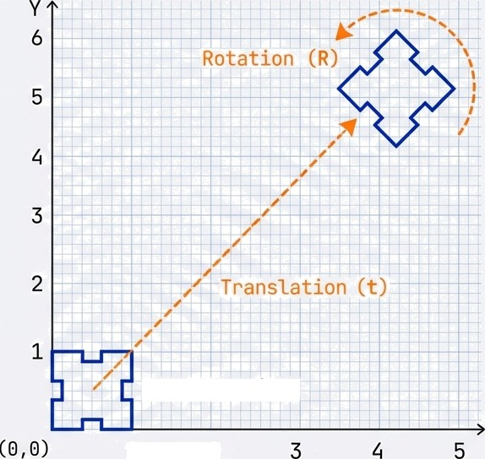
Level The Rigid World in Motion (Euclidean)
We now allow the object to move through space (Translation). This models how solid objects behave in the physical world they turn and they move, but they don't deform.
Real World Use
Object Tracking (identifying a can
moving down a Jane).
Anchor Object
X
1
2

Slide 10
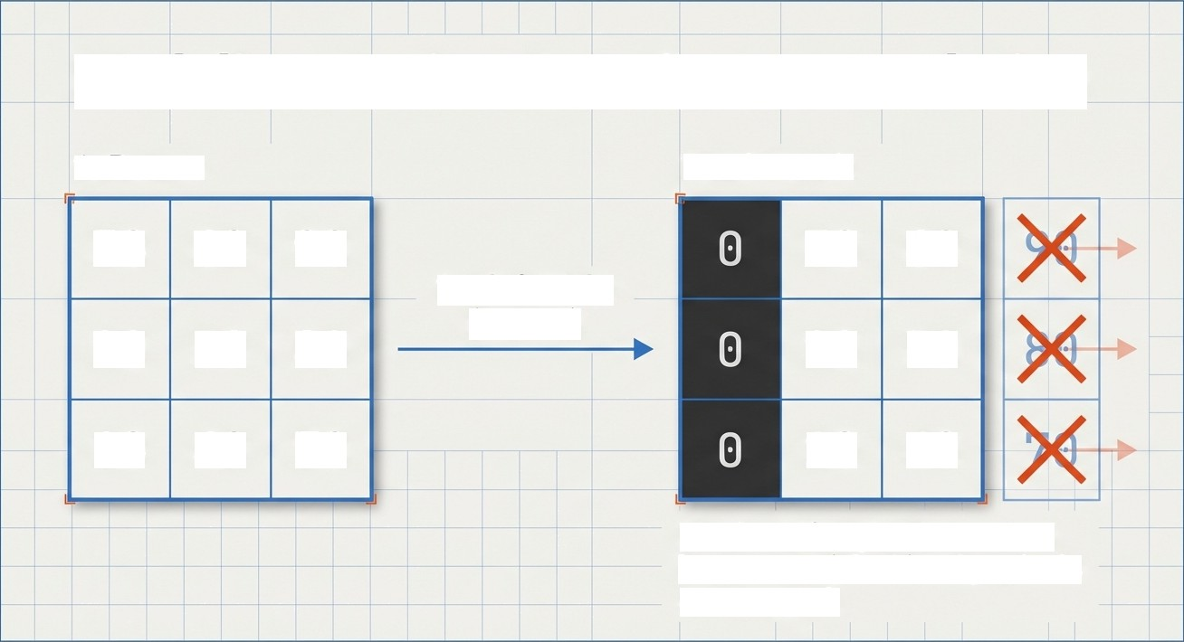
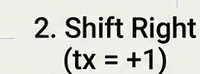
Modeling Motion:Rotation + Translation
1. Rotate Final Result
3â 6â 9â
2â 5â 8â
10 40 70
3â 6â
2â 5â
1â 4â
Pixels shift right. New space becomes 0 (Black). Edge pixels are cropped.

Slide 11
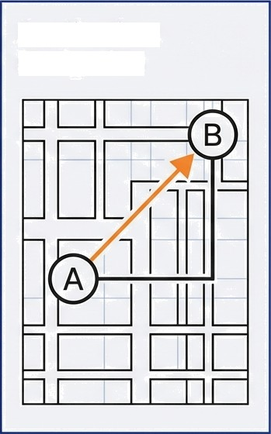




Rotation plus Translation
Application: Navigation
Rotation Matrix.
Handles orientation.
Translation Vector.
Handles position (x, y shift).
This equation combines the complex multiplication of the rotation matrix R with the simple addition of vector t. ENectively, it ‘spins’ the object first, then ‘picks it up’ to place it at a new coordinate.

Slide 12
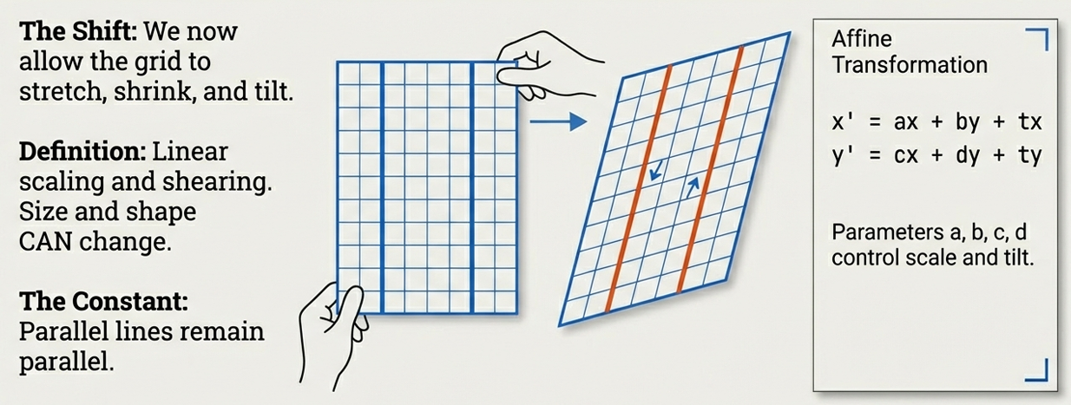
Level 3: Affine Transformation

Slide 13

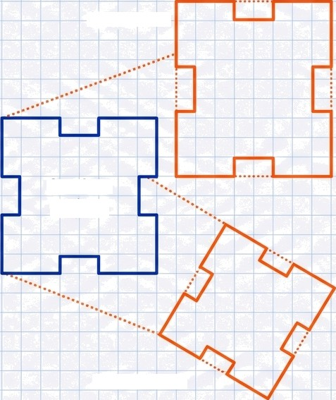
Level Stretching
Reality (Affine)
Scale —›
We break the rigidity. Lines remain parallel, but angles and distances warp. This mimics mimics “shadow logic“ or viewing a flat surface from an angle.
Anchor
Object
Invar1ants
Parallelism (Parallel lines stay parallel)
Ratio of lengths on cotl1near po1nts
Real World Use
Correcting aerial photography taken from a tilted plane.
Shear —›

Slide 14
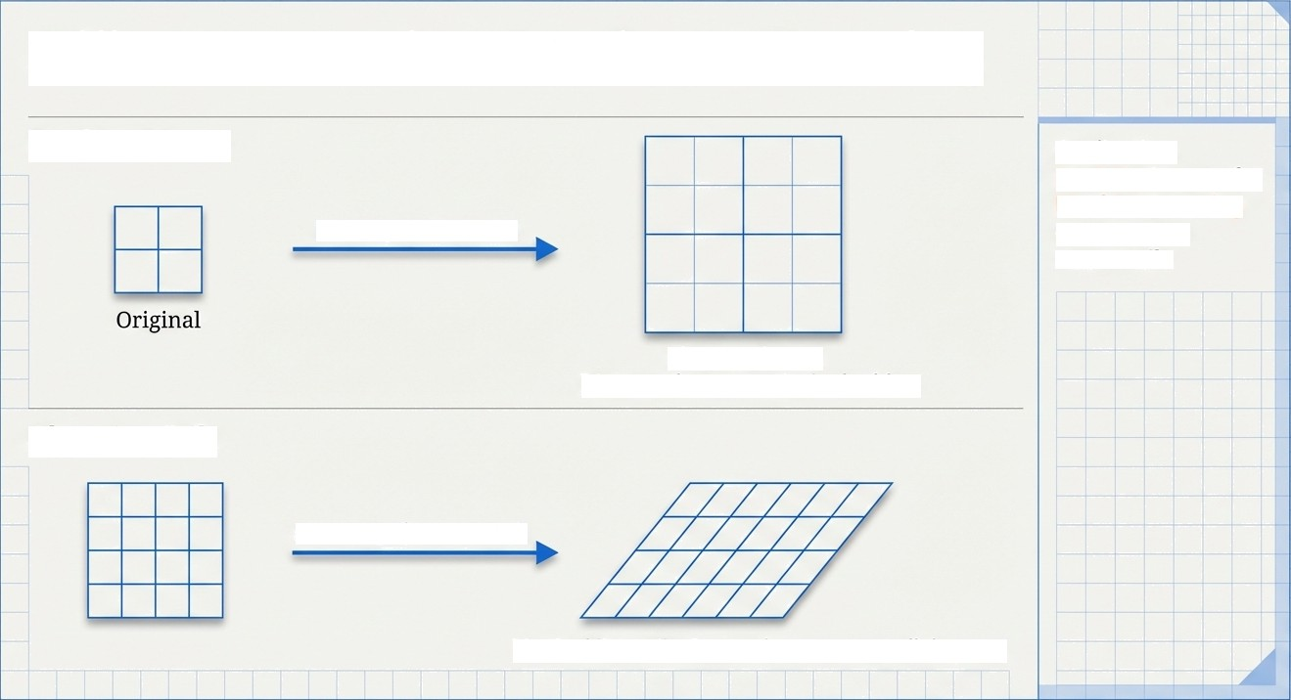
Affine Mechanics: Scaling & Shearing
Scaling/Zoom
Application: Residing images for Machine Learning or correcting camera tilt.
Scaling
(a=2,
d=2)
x’ = 2x, y’ = 2y.
Distance between pixels doubles.
Shearing/Tilt
Shear1nq (x’ = x + y)
Vertical lines tilt. Square becomes parallelogram.

Slide 15
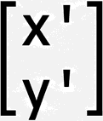
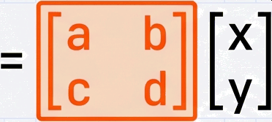
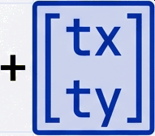
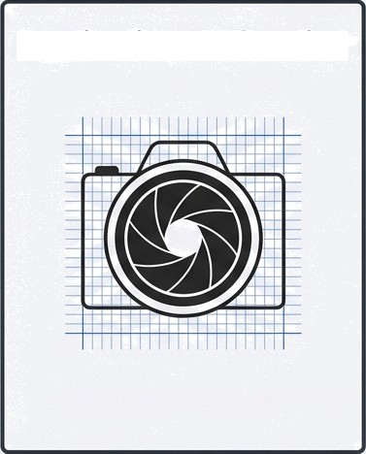


Scale, Shear, and Tilt
Application: Calibration
Linear Transformation Matrix.
These four variables interact to control Scale (zooming) and Shear (slanting).
Translation Vector
(Position).
Unlike Orthogonal rotation, the variables a, b, c, d are not bound by sine or cosine. They can be any value, allowing the grid to stretch and skew.

Slide 16

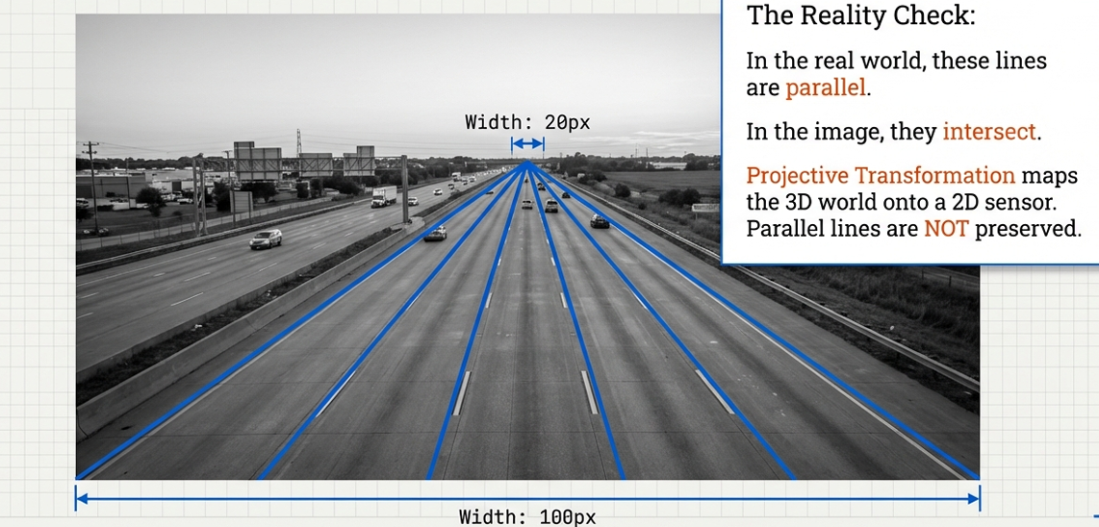
Level 4: Projective Transformation
Width: 20px

Slide 17
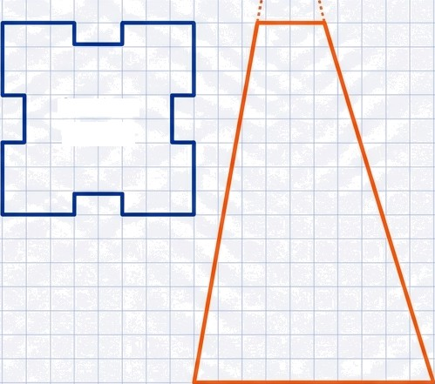
Level 4: The Perspective Shift (Projective)
Vanishing Point X
The most powerful transformation. It models how eyes and cameras actually work: parallel lines converge at a vanishing point.
Invariants
Straight lines nemain straight
Cross-ratio
Anchor
Object
WARNING: Parallel lines are NO LONGER
parallel.
Real World Use
Autonomous Driving (Lane Detection).

Slide 18
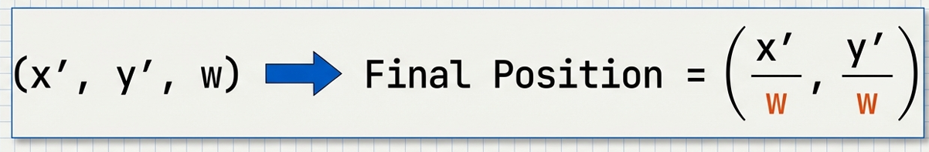
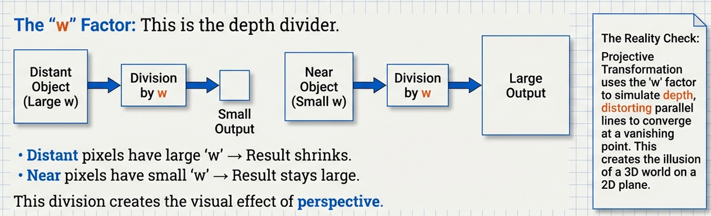
The Math of Perspective: The Homography Matrix
Division by w
Near
Division by w
Large Output
Object
(Small w)

Slide 19



The Hierarchy of Power
Comparing Transformation Complexity
Transformation | Action | Preserves Size? | Preserves Parallel Lines?
Orthogonal JetBrains Mono | Rotate / Mirror | YES | YES
Euclidean JetBrains Mono | Rotate + Shift | YES | YES
Affine JetBrains Nono | Scale + Tilt | NO | YES
Projective JetBrains Mono | Perspective | NO | N0 — Models 3D Depth
As we move down the list, the transformations become more powerful and closer to human vision, but the math becomes more complex.

Slide 20




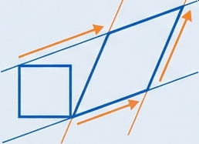
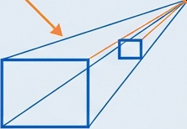
Key Takeaways
Orthogonal
Moves pixels via rotation/mirroring without changing values, shape,
or size.
Euclidean
Changes pixel position via rotation and translation while preserving size and shape.
Afiine
Maps pixels using linear scaling and shearing, allowing size/shape changes while preserving parallel lines.
Projective
The most general form; models 3D perspective where parallel lines converge and size changes with depth.

Slide 21
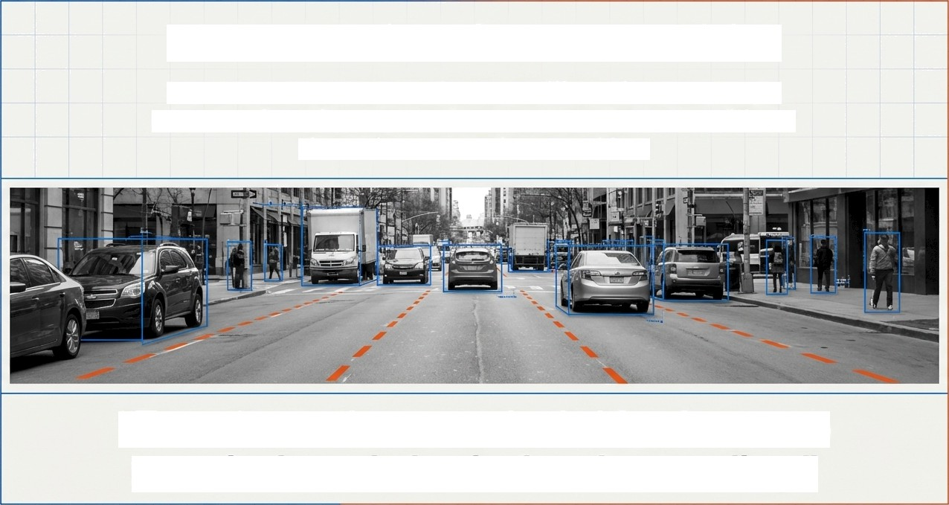
The Foundation of Computer Vision
In the real world, the same object looks different from every angle.
Image transformations allow a robot to understand that these different
views still represent the same object.
“Transformations are the bridge between raw pixels and physical understanding.”

